Slide 1
Predict Price of the Used Cars
Danah aljohar

Slide 2
This model will help predict the price of used cars and help buyers know the real value of cars, so prices cannot be manipulated.
Problem Statement

Slide 3


Data Source

Slide 4
“
I used the dataset from Kaggle.com. It contains information about used Audi cars with many different features such as model, year, price, engine size, etc. This dataset contains more than 10669 records.

Slide 5
Missing values
Data Preparing
Outliers
Label Encoding Technique

Slide 6
Exploratory
Data Analysis

Slide 7
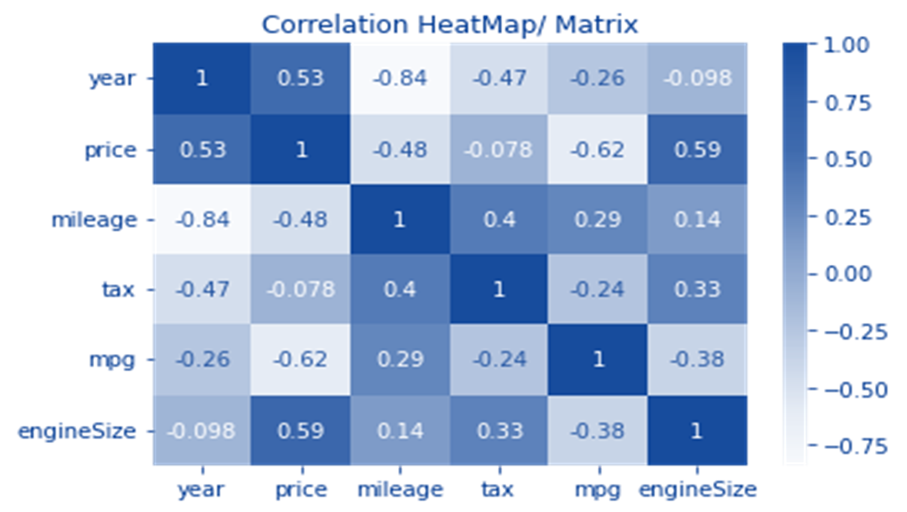
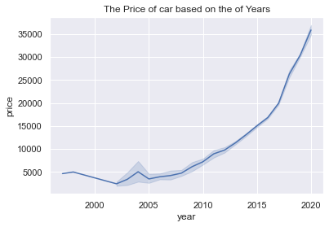
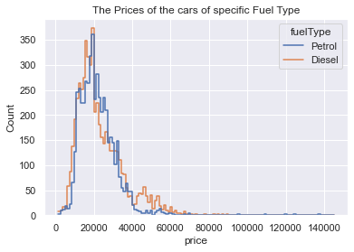
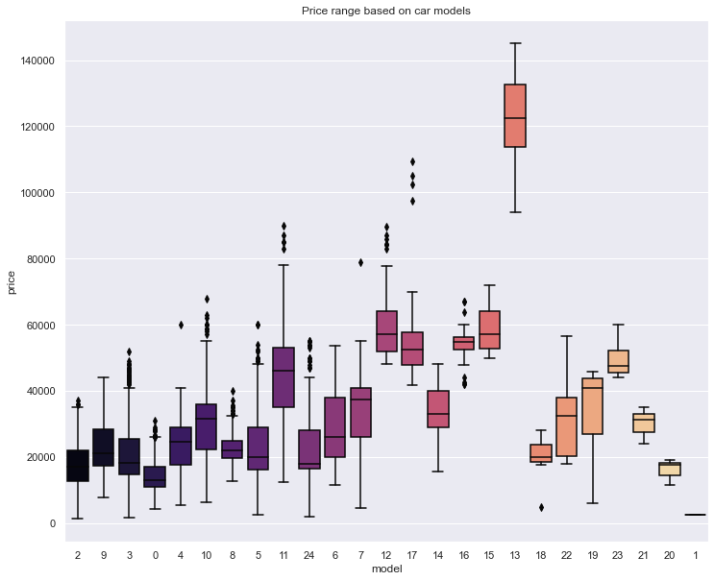

Slide 8
“
Train and Test Data
The data was split into two different parts for model creation: 65% Train and 35% Test.

Slide 9
Models

Slide 10
The accuracy of models
 | Linear Regression | Random Forest | CatBoost(r2)
Accuracy | 80.23% | 95.56% | 96%

Slide 11
Conclusion
As it is clear to us, we can say that CatBoost is the most reliable model because it has the highest accuracy rate.

Slide 12
Thank You

